Slide 1
Operator Overloading

Slide 2
Operator Overloading
C++ has the ability to provide the operators with the special meaning for a data type.
The mechanism of giving such special meanings to an operator is known as Operator overloading.
It provides a flexible option for creation of new definitions for most of C++ operators.
Operator Overloading is a specific case of polymorphism in which some or all of operators like +, =, or == have different implementations depending on the types of their arguments.

Slide 3
Real Life Scenario
Process of Cooking:
  When you are cooking, you need to mix some ingredients. You can add them (like put them in the same plate), divide them (cut), multiply them (like mixing drinks) and so on. I guess that would go for overloading those operators.
Usage of Mobile phone:
    Depending on which menu you have open, buttons do different things. D in a game is forwards and in a SMS it prints the character ‘d’.
Usage of TV at home:
  Same television can be used with DVD player and a set top box.

Slide 4
However if a,b and c are variables(objects) of user defined data type(class) then the statement c=a+b; will not work as complier do not know how to add two variables(objects) of user defined data type(class). Error will be generated.
In order to make this operation possible we need to overload the + operator by making a function to perform the desired task.
This property of giving additional meaning to the existing operators so that they can work with variables of user defined data type is called operator overloading.
Providing additional meaning to an existing operator does not change the original meaning of operator but it simply extends the functionality of operator.

Slide 5
Operator Overloading
Operator overloading refers giving special meaning to an existing operator.
In order to give additional meaning to the operator , we need to overload it by creating an operator function
An operator function defines the operation that the overloaded operator will perform when used with the objects of a relative class
An operator function can be member or non member(friend function) of a class

Slide 6
Syntax for operator function
When declared inside and defined outside the class
return_type classname:: operator#(argument list)
{
Body of function
}
When defined inside the class
return_type operator#(argument list)
{ body of function}

Slide 7
Contd….
We can overload all C++ operators except the following:
Class member access operator(.,.*).
Scope resolution operators(::)
Size operator( sizeof)
Conditional operators(?:)

Slide 8
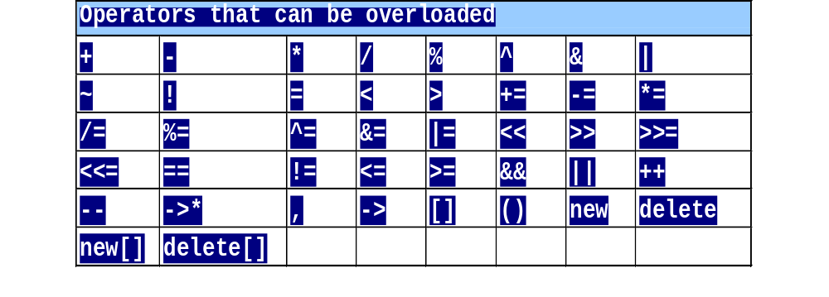
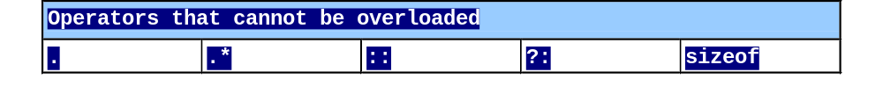
Restrictions on Operator Overloading

Slide 9
The operator keyword is used to overload an operator # which is one of the C++ operator to be overloaded
The complier distinguishes between ordinary member function and operator function of a class by checking the keyword operator.
The name of the operator function is operator#
In order to overload + operator we replace # by +.
The no. of arguments to be passed to operator function depends on whether the operator to be overloaded is unary(++ or --) or binary(+,-,*)

Slide 10
If the operator is unary then the argument list is empty
If the operator is binary the argument list will contain one parameter.
Examples of overloaded operator function:
  void operator ++();
  complex operator +(complex);
  void operator +=(complex);

Slide 11
Steps in process of overloading
Create a class that defines data types that is to be used in the overloading operation.
Declare the operator function operator op() in public part of the class. It may be either member function or a friend function.
Define the operator function to implement the required operation.

Slide 12
Types of Operator
Unary operator
Binary operator
Notes:
Student Book

Slide 13
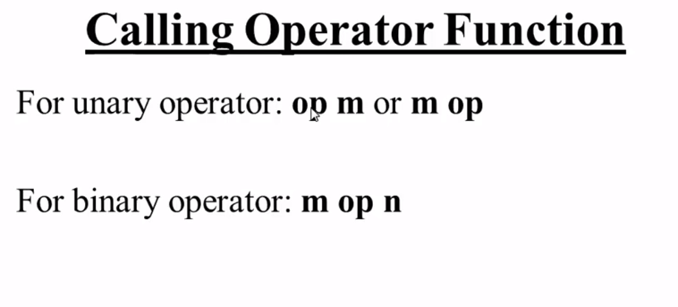

Slide 14
Operator invocation
Overloaded operator functions can be invoked (for binary operator) as:
x op y
Can be interpreted as:
x . operator op (y) → for member function
operator op (x , y) → for friend function

Slide 15
Types of Operators
Unary operator
Binary operator
Operators | Member Functions | Non Member Functions (Friend Function)
Unary operator | No Parameter | One Parameter
Prefix postfix | 0 1(int) | 1 2 (class object, int)
Binary operator | One Parameter | Two Parameters
Notes:
Student Book
++i means i.operator()

Slide 16
Unary Operators
The unary operators operate on a single operand (-a, +a, --a, a--, ++a, a++)
Notes:
Student Book
The pre and post increment and decrement operators and overloading in different ways. This is because they have a different effect on objects and their values.
e.g. a=14;
cout << a++; // will print 14 and increment a
cout << ++a; // will increment a and print 15

Slide 17
Overloading Unary Operator
Are defined by either a member function that takes no parameter or a non-member function that takes one parameter
Example:
i1.operator -()
or
operator -(i1)
or
-i1

Slide 18
Create a class item, having three data members x ,y and z, overload ‘-’ (unary operator) to change the sign of x, y and z
class abc
{
private:
int x;
int y;
int z;
public:
abc (int a, int b, int c)
{
x=a;
y=b;
z=c;
}
void display()
{
cout<<x;
cout<<y;
cout<<z<<"\n";
}
void operator-()
{
x=-x;
y=-y;
z=-z;
}
};
int main()
{
abc s(10,-20,30);
cout<<"s :";
s.display();
-s;
cout<<"s :";
s.display();
return (0);
}

Slide 19
It is possible to overload a unary minus operator using friend function
friend void operator- (space &s); //declaration
void operator- (space &s) //definition
{
s.x = -s.x;
s.y = -s.y;
s.z= -s.z;
}

Slide 20
unary – operator that negates the object of point class
#include <iostream.h>
class point
{
int x, y;
public:
point()
{
x = 0; y = 0;
}
point(int i , int j)
{
x=i; y=j;
}
point operator –( );
void display()
{
cout<<x<<“\t”<<y;
}
};
// Operator – operator for point class
point point::operator-( )
{
x=-x;
y=-y;
}
int main()
{
point o1(10 , 10);
-o1; //Negate the object
o1.display();
}

Slide 21

Example of overloading Unary operator
int main()
{
score s1,s2; // object definition
cout<<"\n initial value of s1 object = "<<s1.show();
cout<<"\n initial value of s2 object = "<<s2.show();
++s1; //operator function call
++s1; // same as s1.operator++();
++s2;
cout<<"\n final value of s1 object = "<<s1.show();
cout<<"\n final value of s2 object = "<<s2.show();
return 0;
}
#include<iostream.h>
using namespace std;
class score
{
private: int val;
public: score()
{ val=0;}
void operator++() //operator function definition
{ val= val+1; }
int show()
{ return (val); }
};

Slide 22
Binary Operators
Binary operator works on two operands
(a-b, a+b, a*b, a/b, a%b, a>b, a>=b, a<b, a<=b, a==b)
Notes:
Student Book

Slide 23
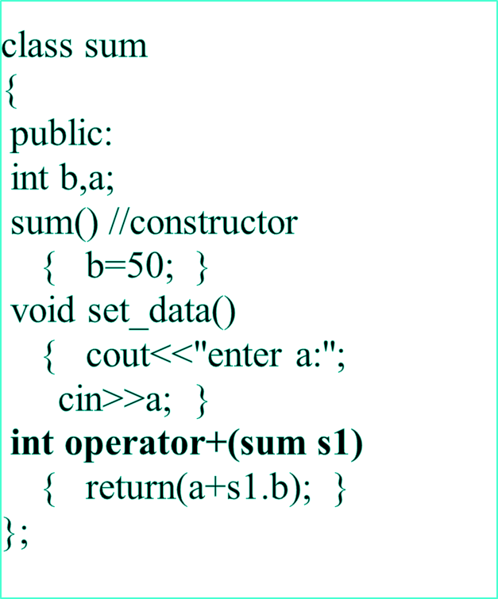
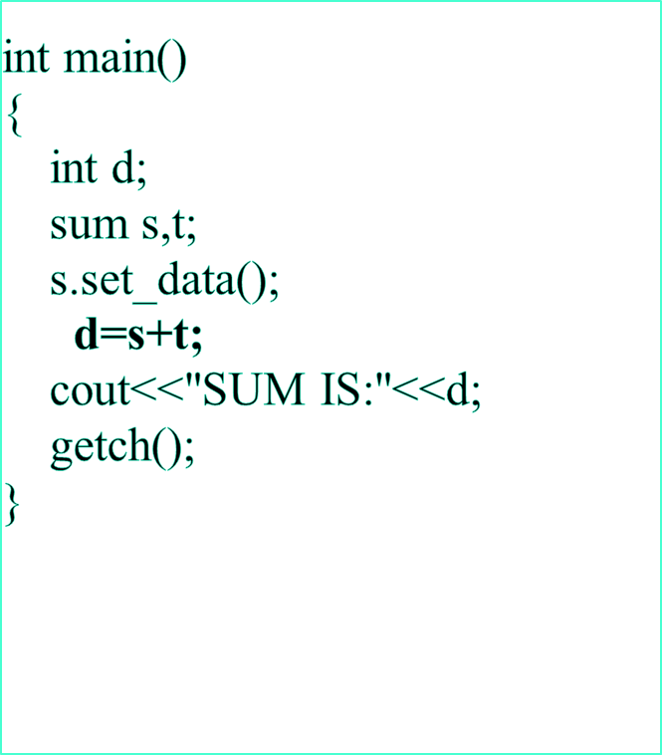
Program to overload + (addition) operator.
Notes:
Here the contents of object s and t are added thus + operator is overloaded

Slide 24
Addition of complex numbers
class complex
{ int x, y;
public:
complex()
{ x=10; y=20;}
Complex(int a,int b){x=a;y=b}
complex operator +(complex c)
{
complex temp;
temp.x= x+ c.x;
temp.y=y+c.y;
return(temp);
}
void show()
{ cout<<x<<“+i”<<y; }
};
int main()
{ complex C1(2,3),C2(4,5),C3;
C3=C1+C2;
C3.show();
}
C3=c1+c2
C3=c1.operator+(c2);

Slide 25
Overloading binary operator using friends
Declaration-
Friend complex operator+(complex, complex);
Definition-
Complex operator+(complex e1, complex e2)
  { complex temp;
  temp.x = e1.x + e2.x;
  temp.y = e2.y + e2.y;
  return (temp);
  }
  Calling
  E3= operator+(e1,e2);

Slide 26
Rules for overloading operators.
Only existing operators can be overloaded. New operators cannot be created.
The overloaded operator must have at least one operand that is of user defined type.
We cannot change the basic meaning of the operator.
Overloaded operators follow the syntax rules of the original operators. They cannot be overridden.

Slide 27
Rules for overloading operators.
There are some operators that cannot be overloaded.
We cannot use friend functions to overload certain operators. Member functions can be used to overload them.
Unary operators overloaded by means of member function, take no explicit arguments and return no explicit values.

Slide 28
Rules for overloading operators.
Binary operators overloaded through a member function take one explicit argument.
When using binary operators overloaded through a member function, the left hand operand must be an object of the relevant class.

Slide 29
Which are the operators that cannot be overloaded in C++?(neither by member functions or global/friend function)
1. sizeof operator
2. class member access operator(., .*)
3.Conditional operator(:?)
4.Scope Resolution operator (::)
Which are the operators that cannot be overloaded by global/friend function(means operator that can be over loaded as member functions only)
1. assignment operator(=)
2.class member access operator(->)
3.subscripting operator []
4.function call operator ()

